Slide 1
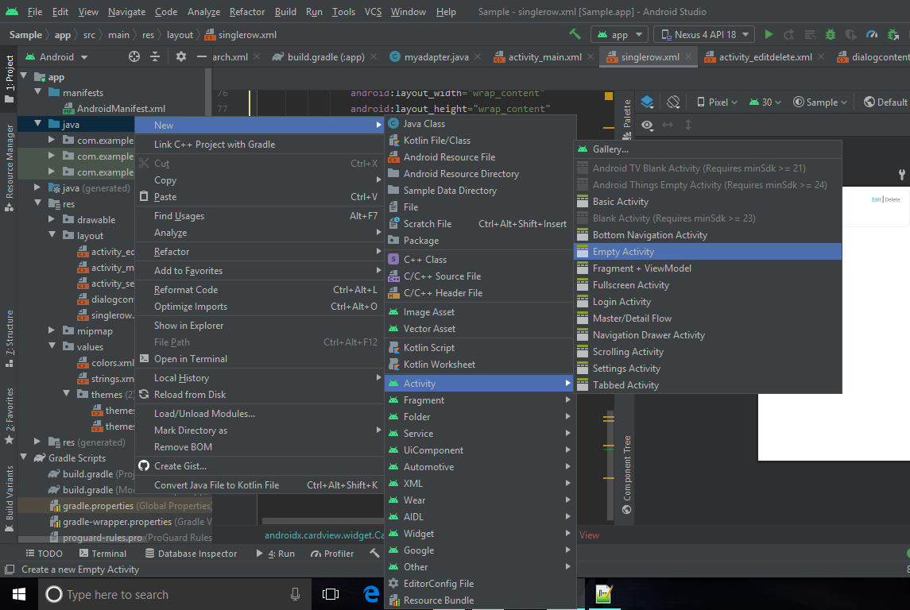
Make a Search Function
Start a new Empty Activity.
Place your screenshot here

Slide 2
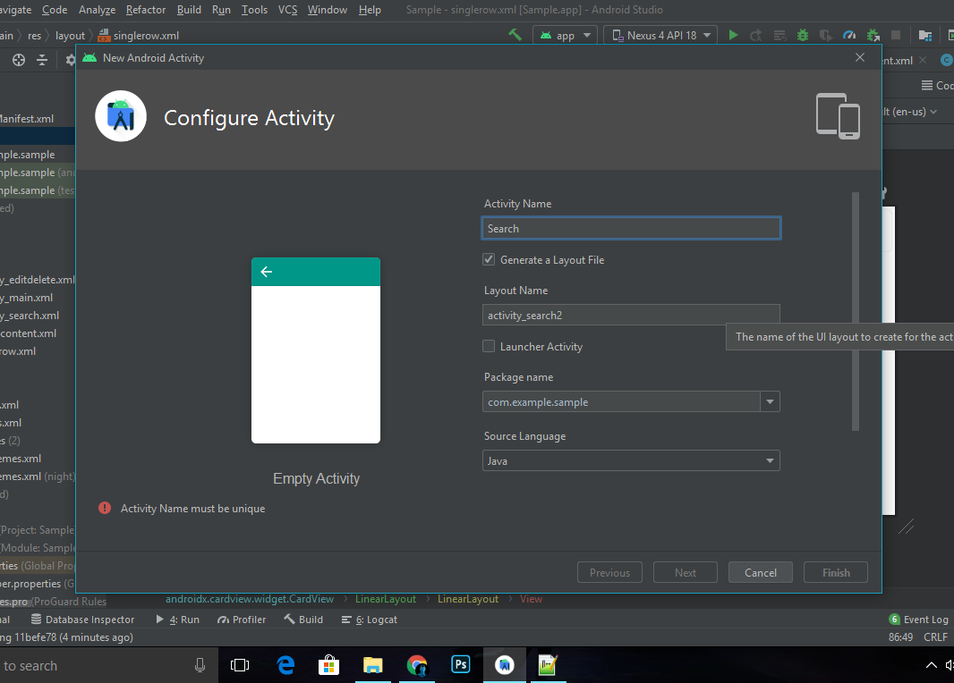
Name your Activity (ex. Search).
Place your screenshot here

Slide 3
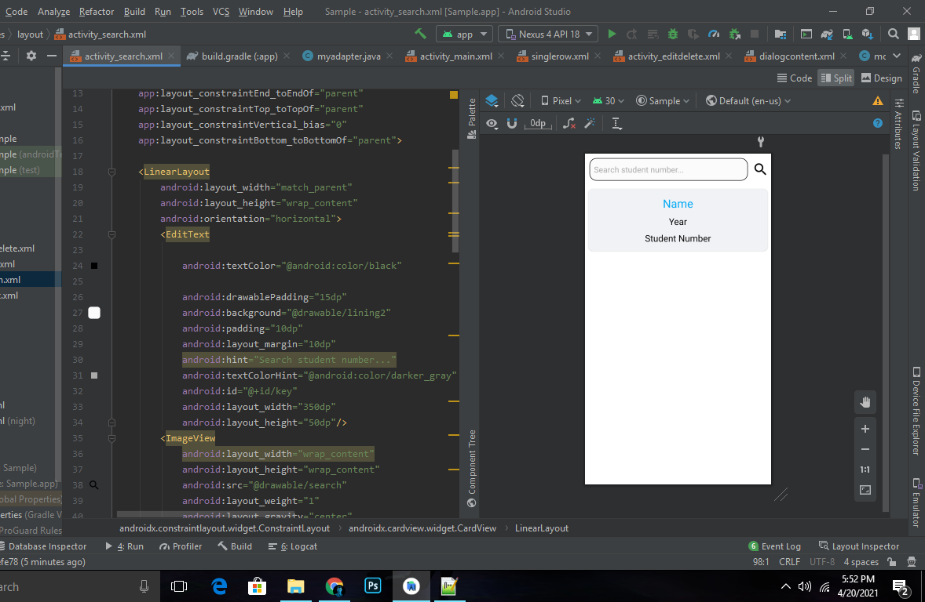
In XML Layout, create 1 EditText View, 3 TextViews and a Button.
Ps. This example used ImageView as a Button.
Place your screenshot here

Slide 4
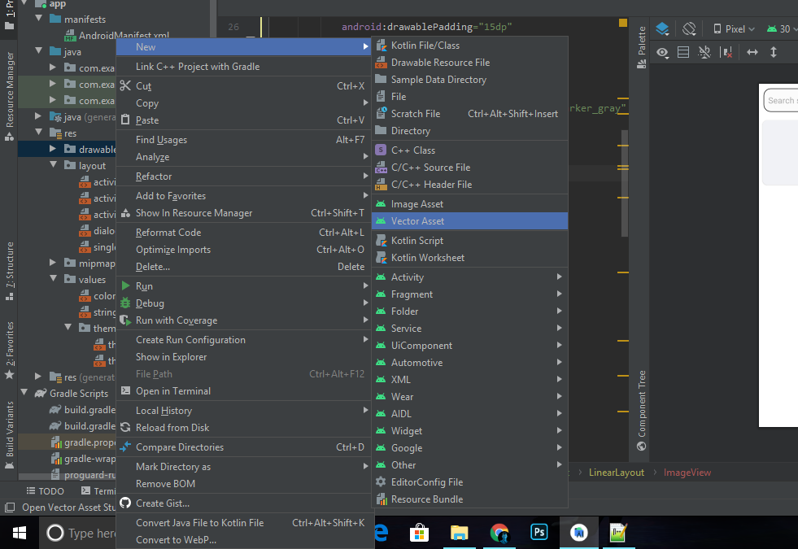
Creating an icon.
Place your screenshot here

Slide 5
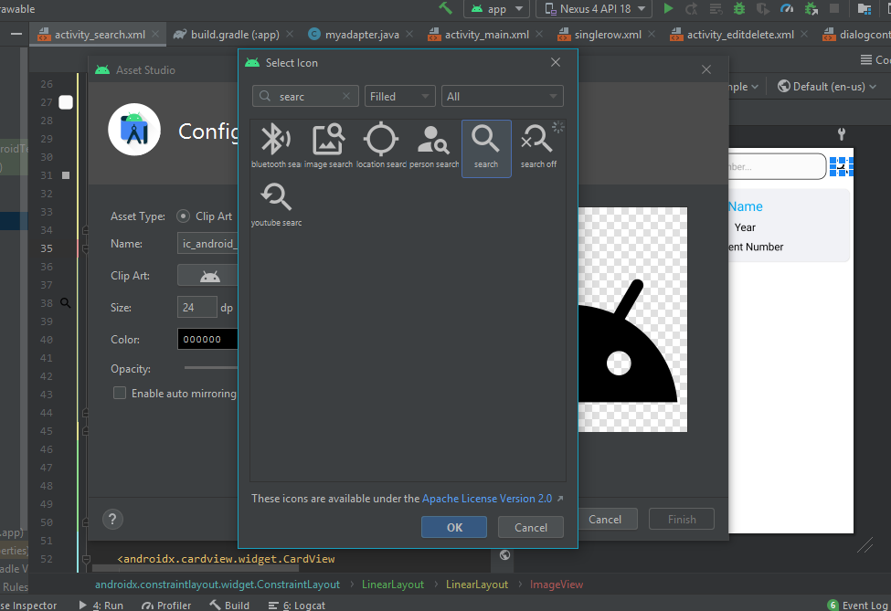
Choose an icon.
Place your screenshot here

Slide 6
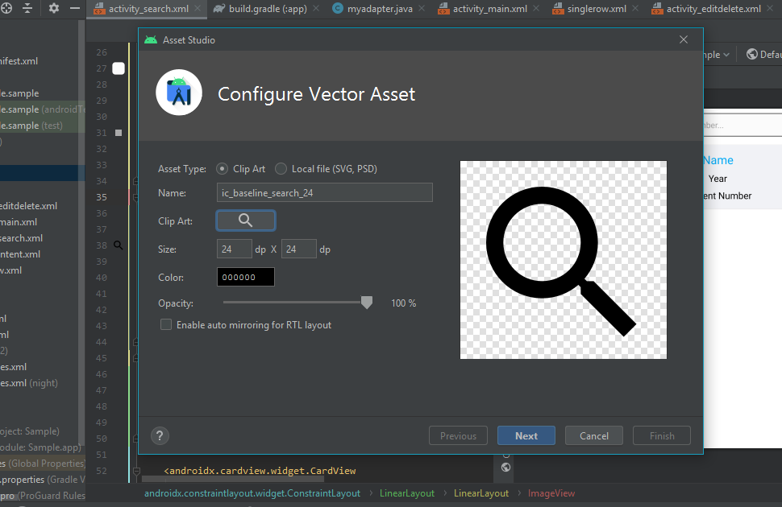
Name the icon and it will be saved to Drawable Folder.
Place your screenshot here

Slide 7
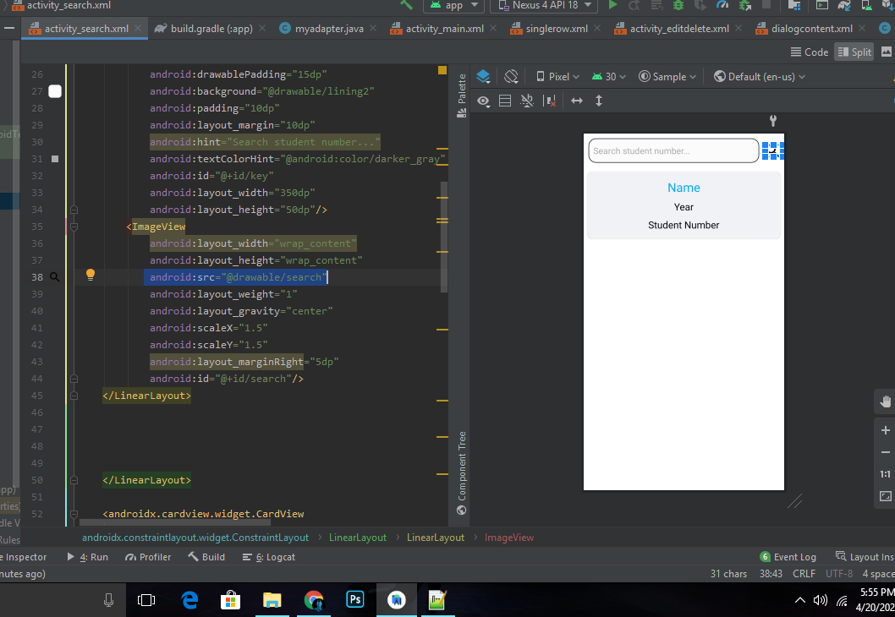
To call the icon you have created, use the android:src=“” attribute (ex. android:src=“@drawable/search”) .
Place your screenshot here

Slide 8
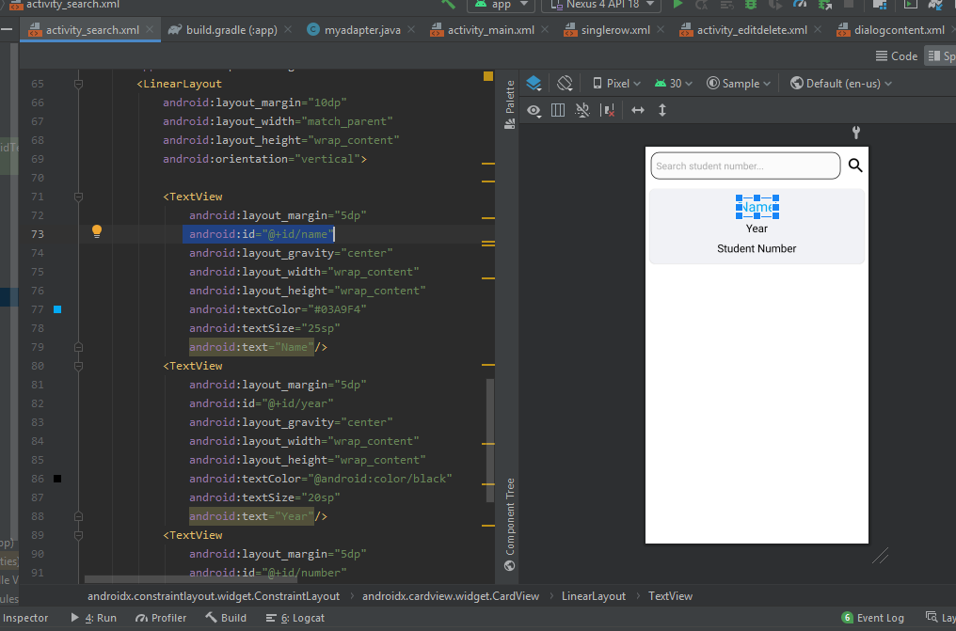
Put ID in Views Ex. (name, year, number and search).
Place your screenshot here

Slide 9
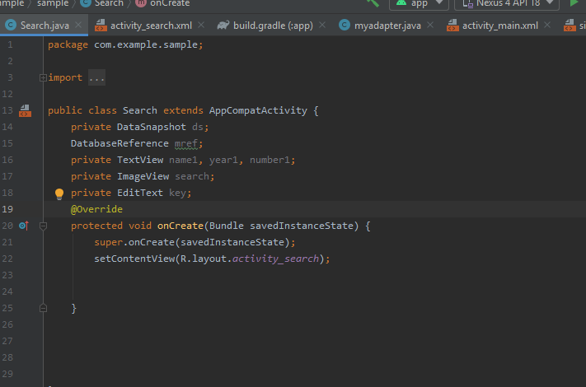
In Java Code, first declare your variables .
Place your screenshot here

Slide 10
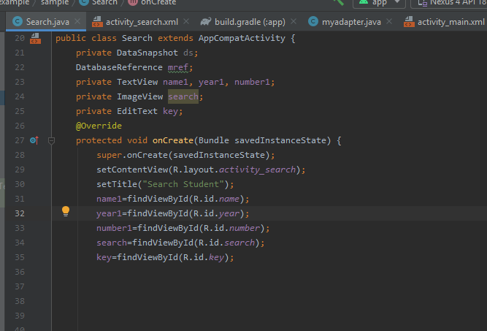
Call the Views created in XML Layout.
Place your screenshot here

Slide 11
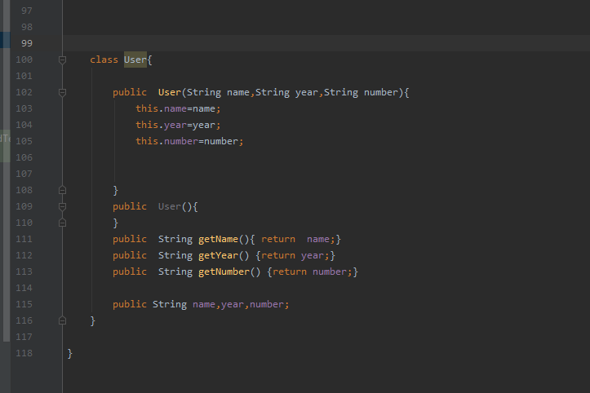
Make a class that will turn your data from Firebase into a string for AS.
Place your screenshot here

Slide 12
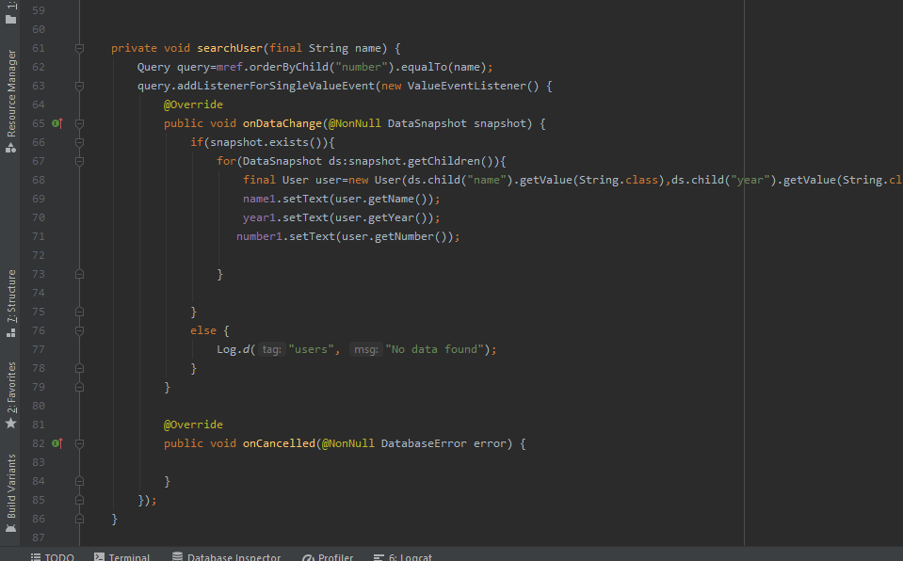
Creating a Void that has Query to make a key that will search data from Firebase.
Place your screenshot here

Slide 13
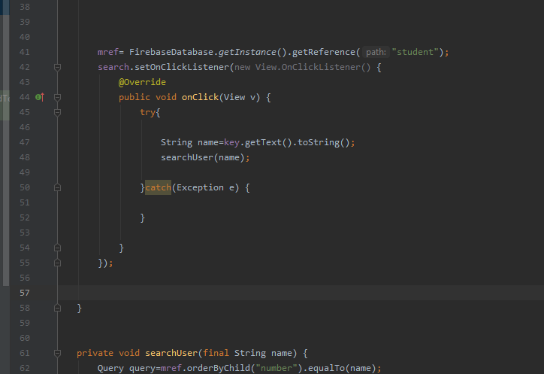
Implement Onclick in the button and insert the search Void.
Place your screenshot here

Slide 14
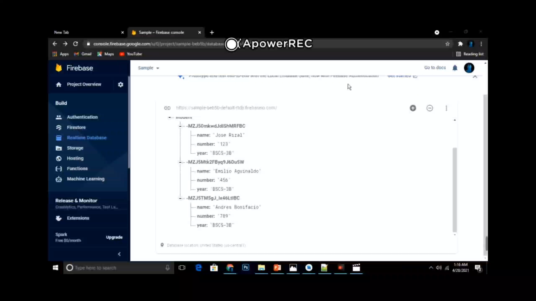
AS Search Data from Firebase

Slide 15
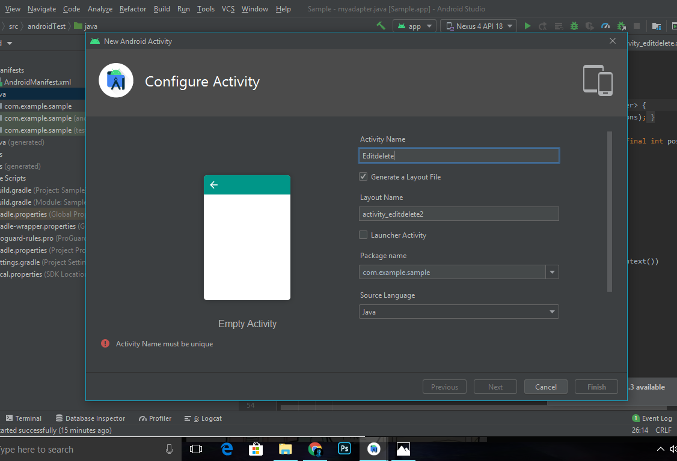
Make an Edit and Delete Function
Make a new Empty Activity. Name your Activity (ex. Editdelete).
Place your screenshot here

Slide 16
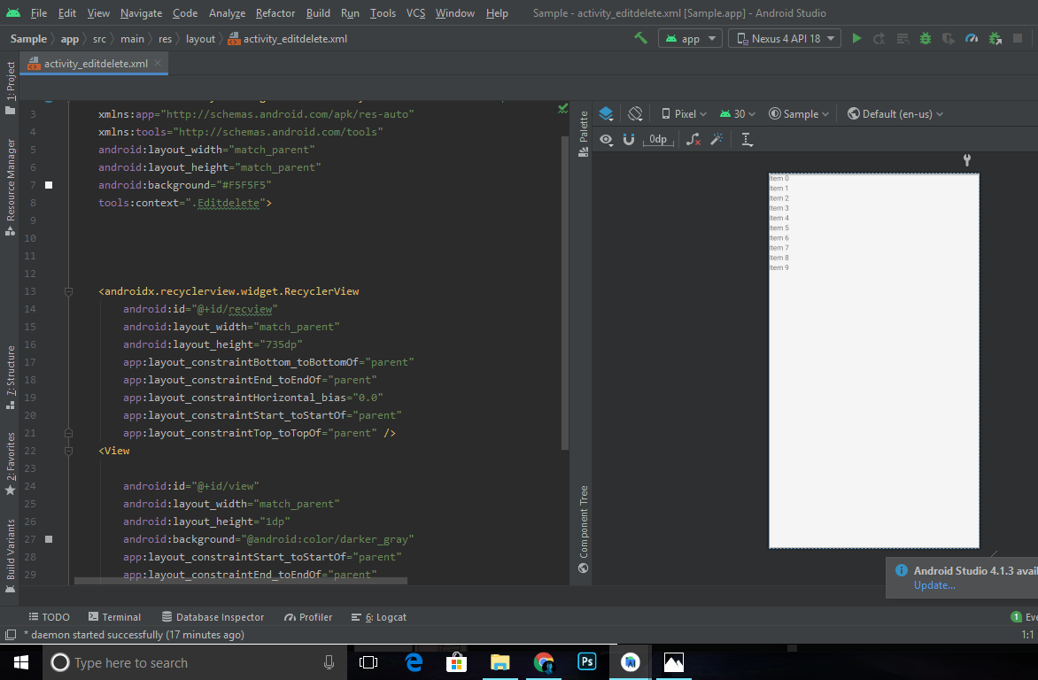
In XML Layout, Create 1 RecycleView and put ID (ex. recview).
Place your screenshot here

Slide 17
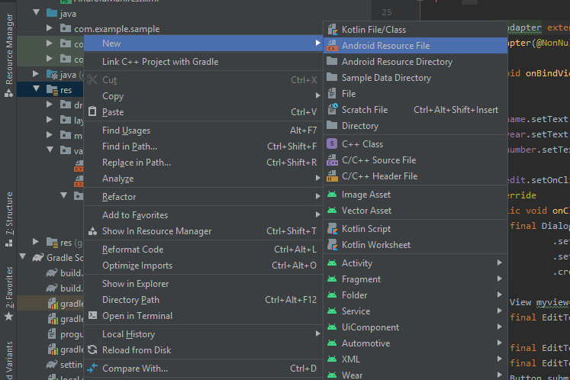
Create a Resource File.
Place your screenshot here

Slide 18
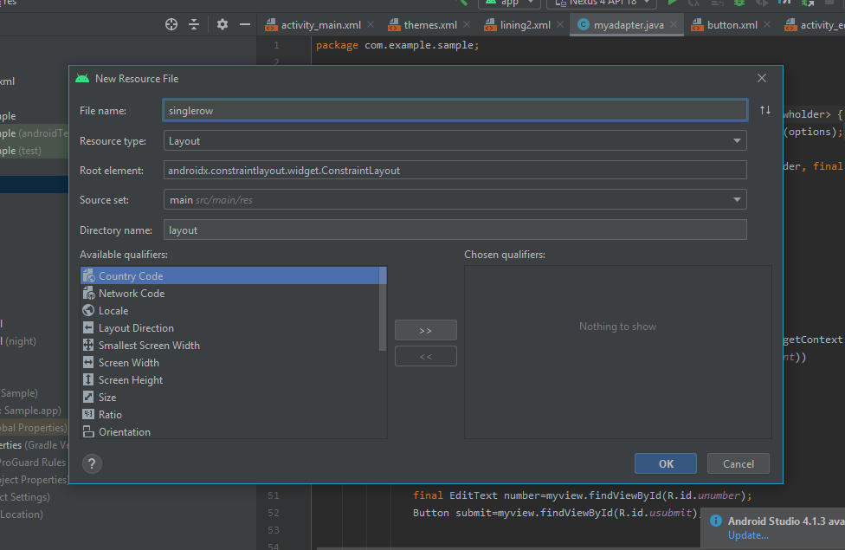
Create a Resource File for a row of list of data (ex. single row). This row will hold the views of a certain data from the Firebase.
Place your screenshot here

Slide 19
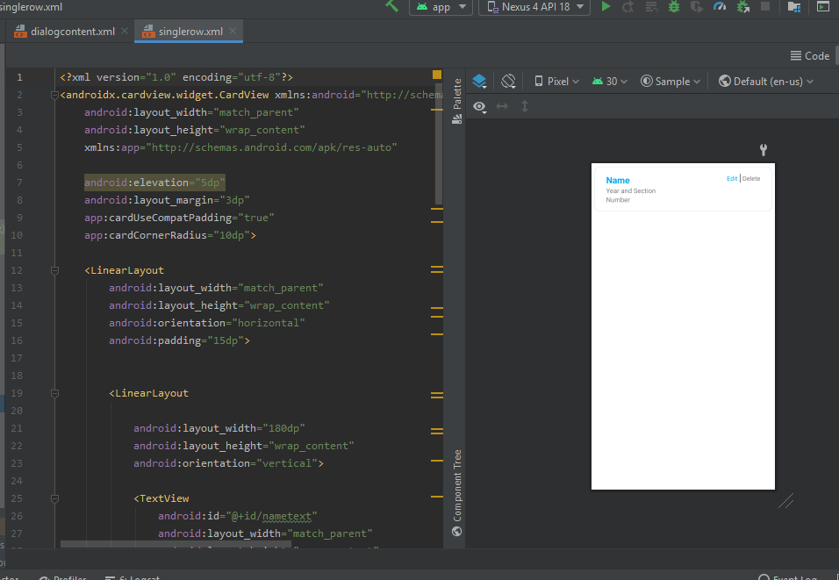
Add Views that will show data in a single row and add edit and delete button and distribute Ids.
Place your screenshot here

Slide 20
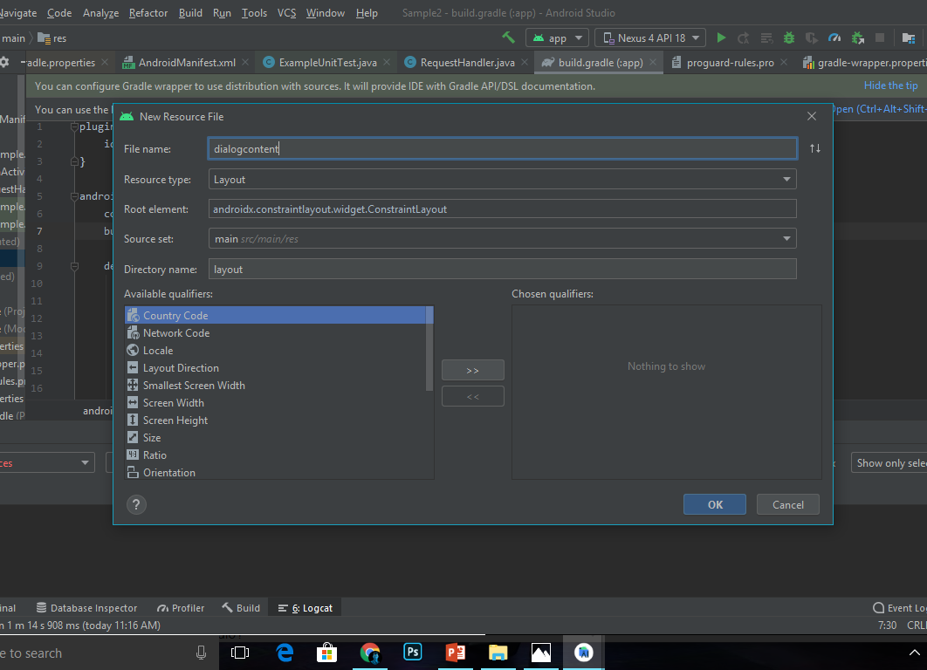
Create a Resource File for Update dialog (ex. dialogcontent). This will show the update function dialog.
Place your screenshot here

Slide 21
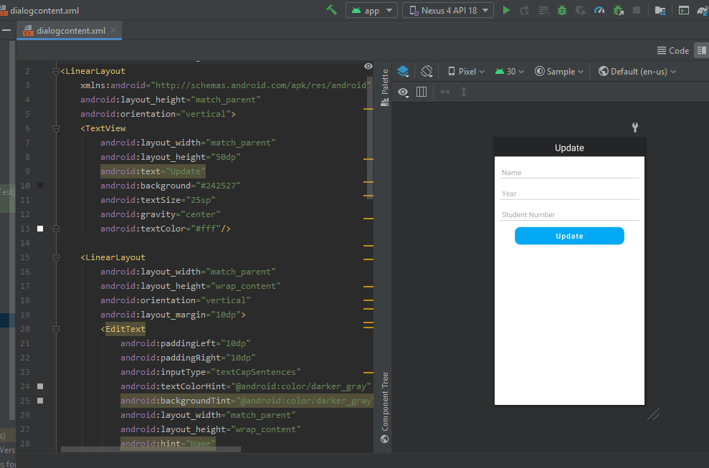
Create a 3 EditText and one Button for the Update Panel and distribute Ids.
Place your screenshot here

Slide 22
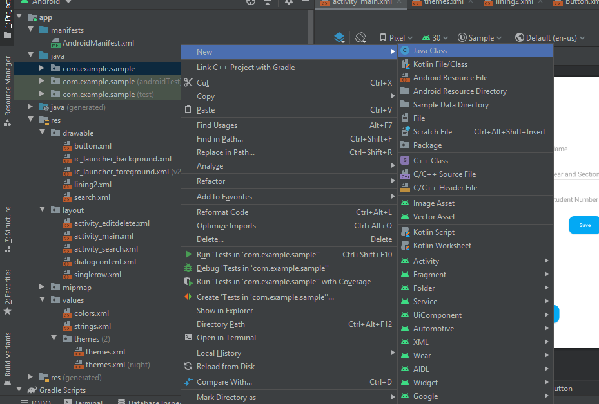
Make a Java Class.
Place your screenshot here

Slide 23
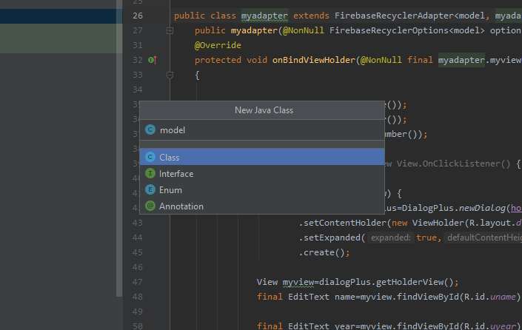
Create a Java Class for the string model.
Place your screenshot here

Slide 24
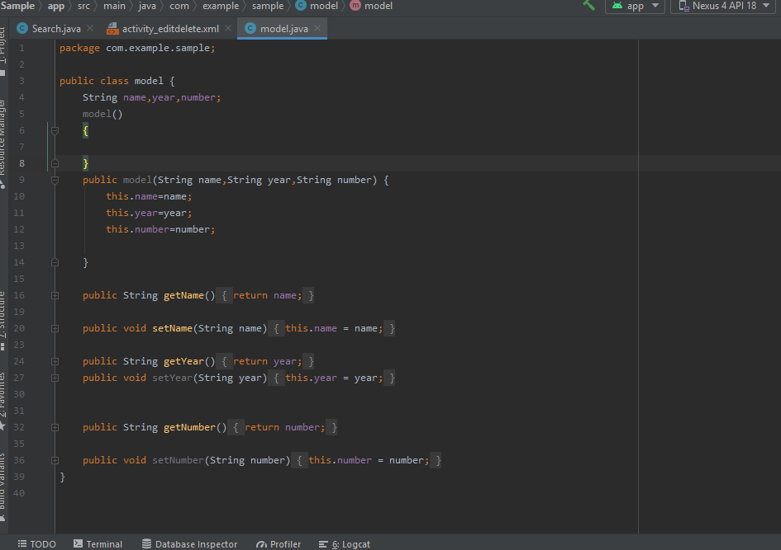
The Model Java Class will make the data from Firebase into readable string to AS.
Place your screenshot here

Slide 25
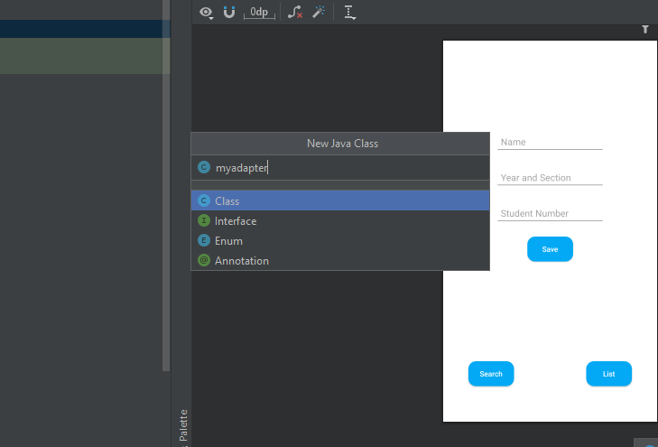
Create a Java Class for the adapter (ex. myadapter). The adapter will be the holder of data and functions of a row of data in recycler viewer.
Place your screenshot here

Slide 26
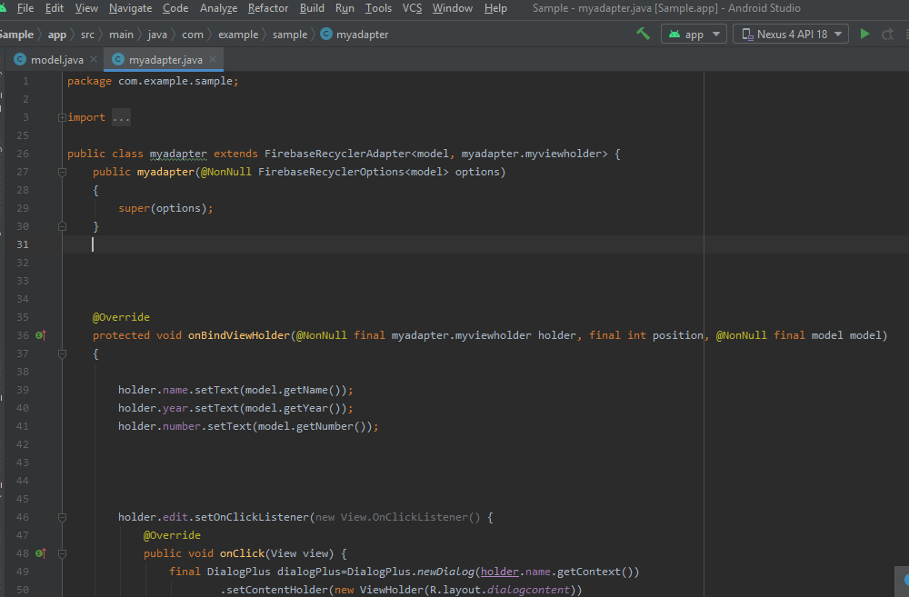
In Adapter Java Class, use Firebase Recycler Adapter as Options.
Create an OnBindViewHolder Method, this will hold the Edit and Delete Function. Declare the key value that have created in the model.
Place your screenshot here

Slide 27
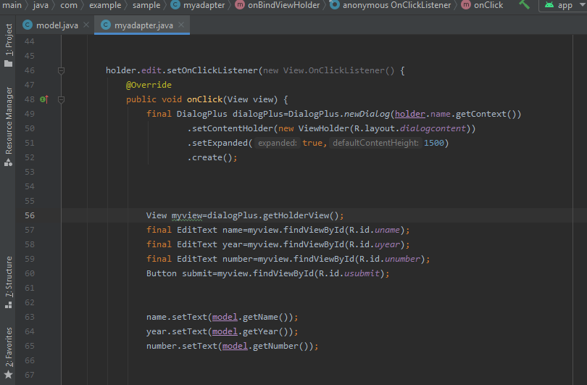
Create an Holder Edit Onclick and declare your dialog xml as it’s layout.
Declare the Variables and distribute it into your model.
Place your screenshot here

Slide 28
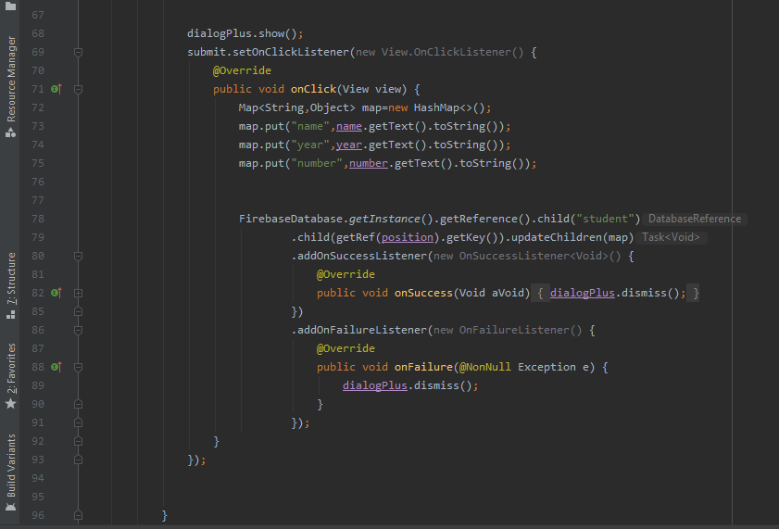
Create a submit/save onclick and HashMap method to rewrite the existing data in the Firebase.
Place your screenshot here

Slide 29
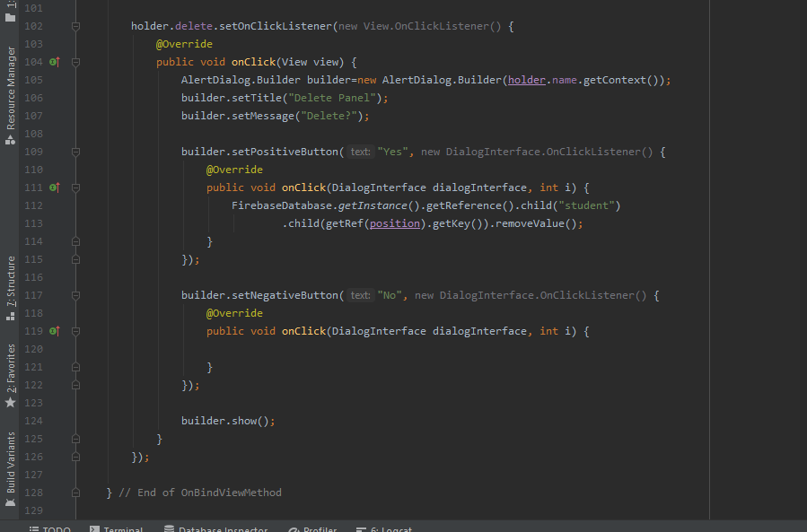
Create a Holder Delete Onclick, this will delete data from the chosen row in the list and also data in the Firebase Database.
Place your screenshot here

Slide 30
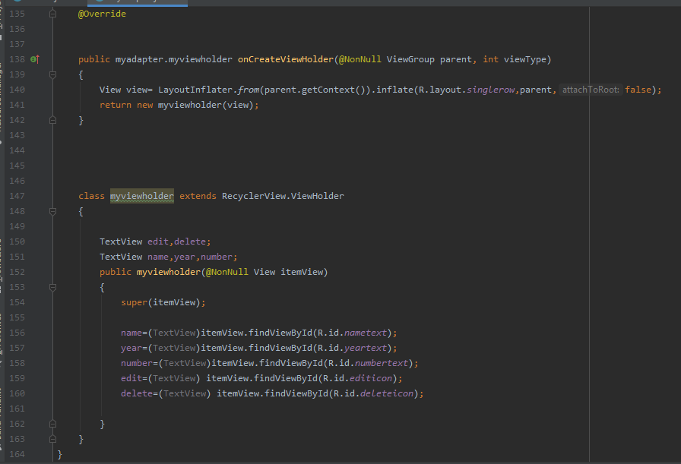
Create a ViewHolder, this will hold the data in an single row of list and declare your row xml layout.
Create a class that contains the variables and view distributions from layout.
Place your screenshot here

Slide 31
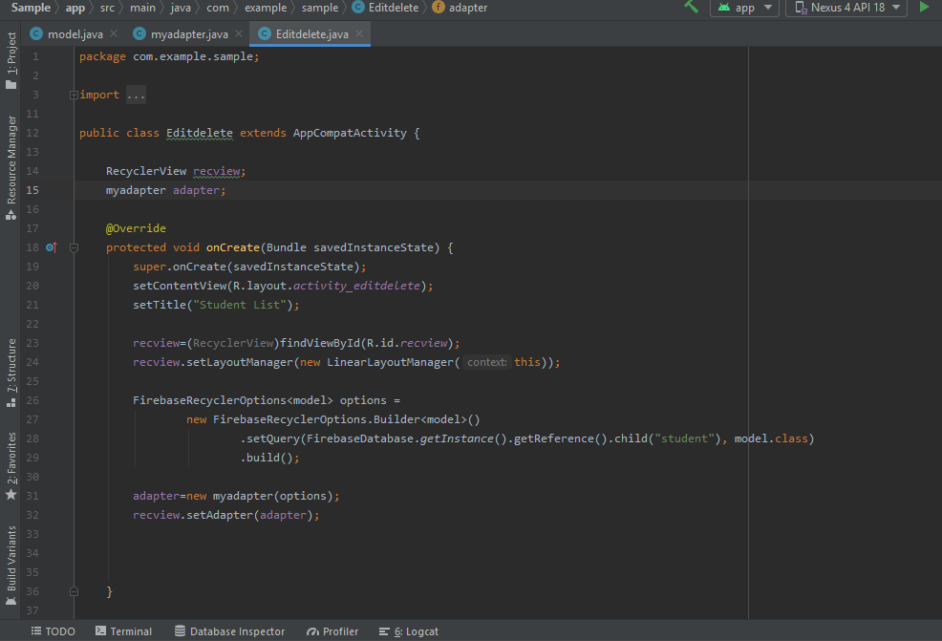
In the Third Activity Java created (ex. Editdelete.java), declare the variables and call the views in layout. RecyclerView will use RecyclerOptions to List all the data inserted in the Firebase
Place your screenshot here

Slide 32
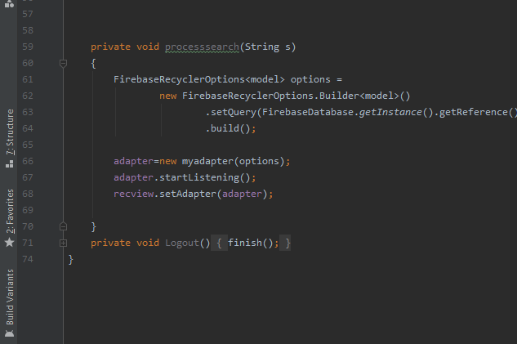
This Void will query all the data in the Firebase.
Place your screenshot here

Slide 33
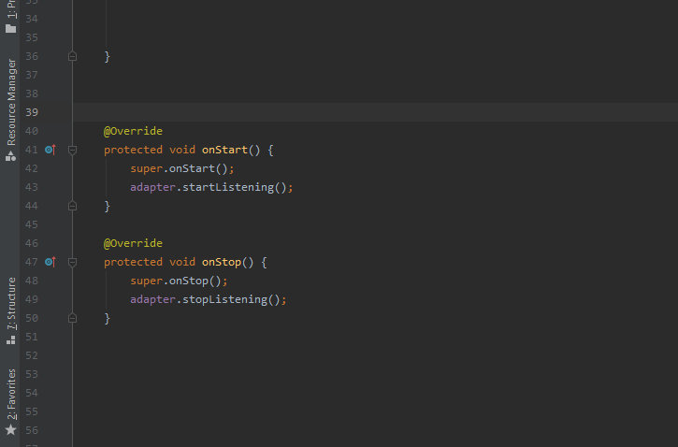
This Voids will start and stop the listing of the data inside the databse.
Place your screenshot here

Slide 34
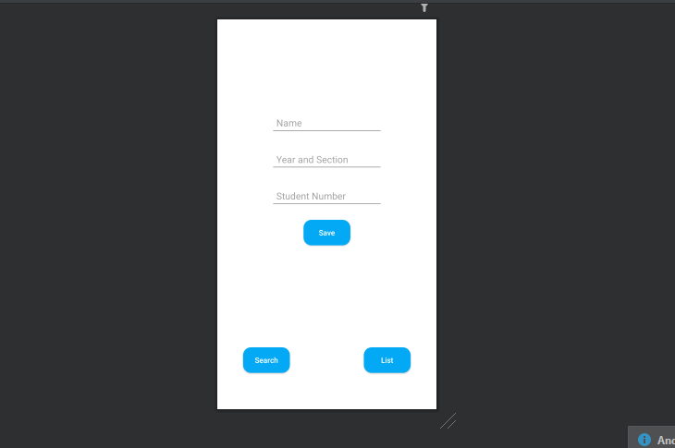
Create Buttons in Main Activity Layout that will open Search and Edit/Delete Activity.
Place your screenshot here

Slide 35
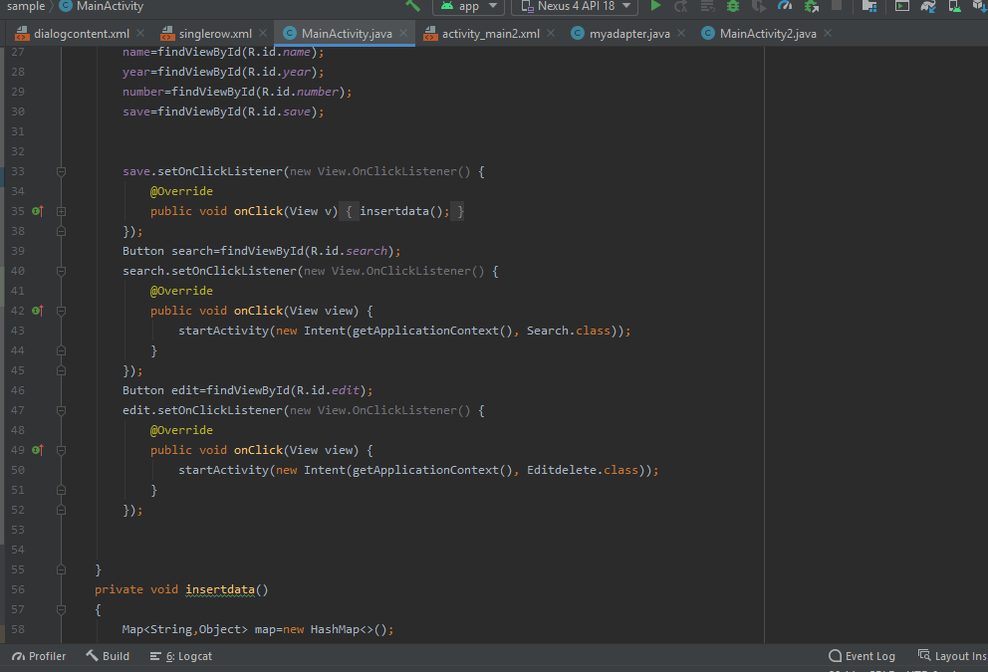
In Main Activity, create an Intent for the Search Activity and Edit/Delete Activity.
Place your screenshot here

Slide 36
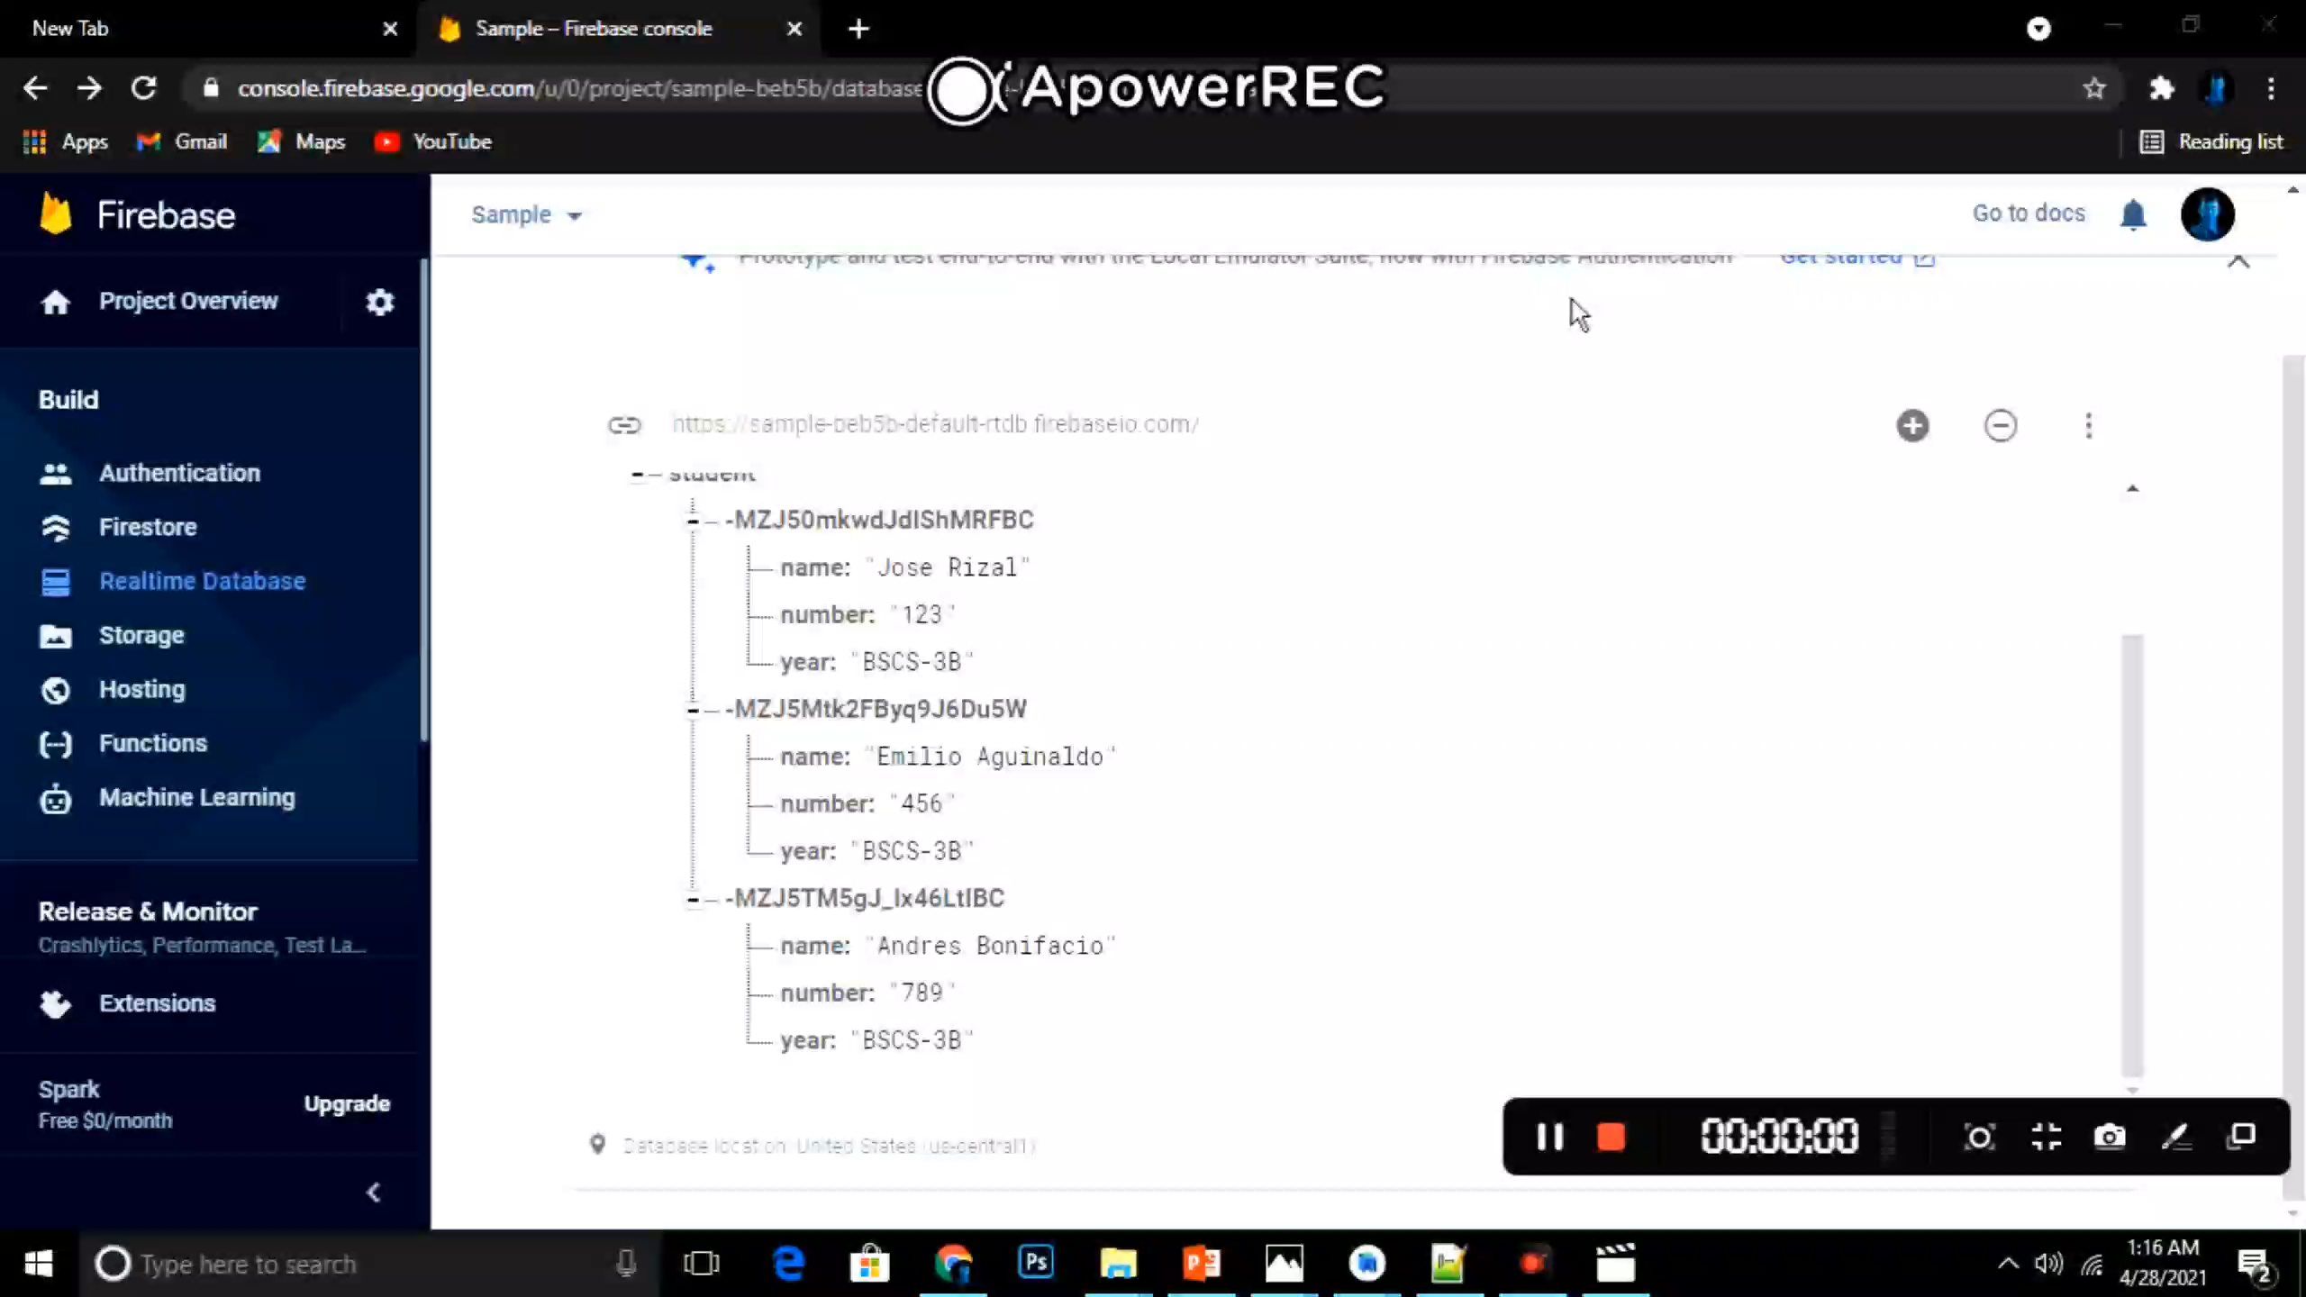
AS Update Data from Firebase

Slide 37
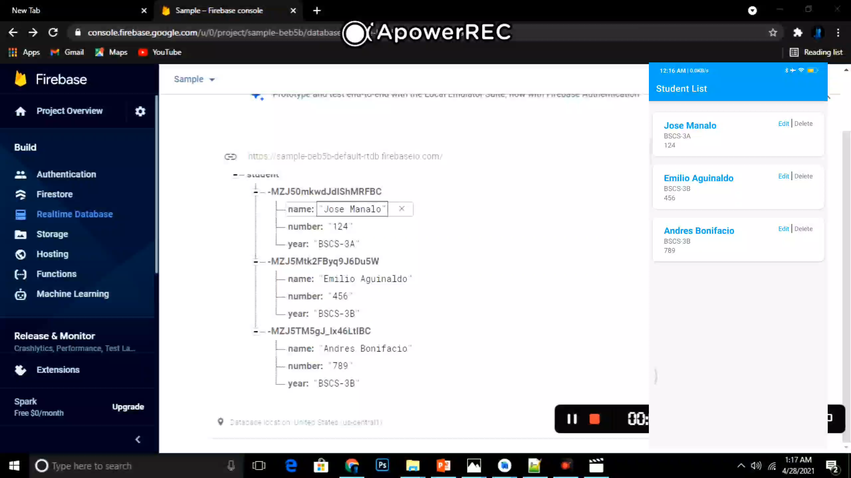
AS Delete Data from Firebase

